Slide 1
Mechanics
2-Person Umpire System

Slide 2
On Field Positions
Times to start in the “A” Position
No runners on Base

Slide 3
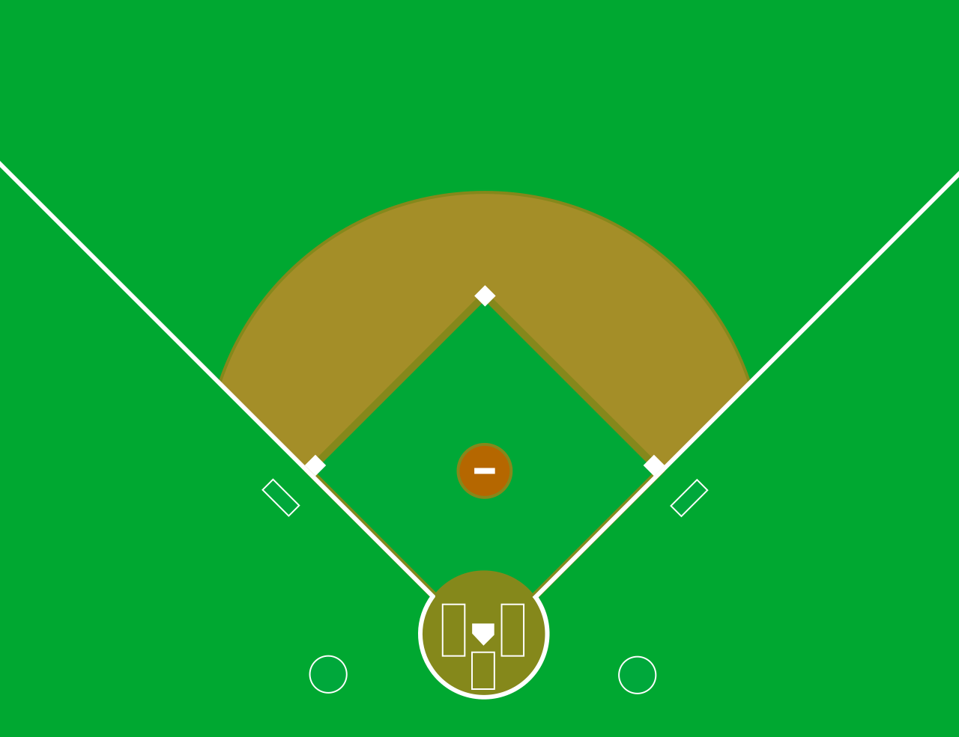
“A” Position
U1
PU

Slide 4
On Field Positions
Times to start in the “B” Position
Runner on 1st Base Only
Runners on 1st and 3rd.

Slide 5
“B” Position
U1
PU

Slide 6
On Field Positions
Times to start in the “C” Position
Any time there’s a runner on 2nd
Bases Loaded
Runner on 3rd Only
Runners on 2nd and 3rd

Slide 7
“C” Position
U1
PU

Slide 8
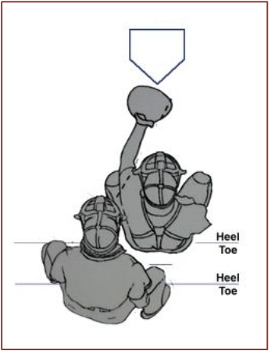
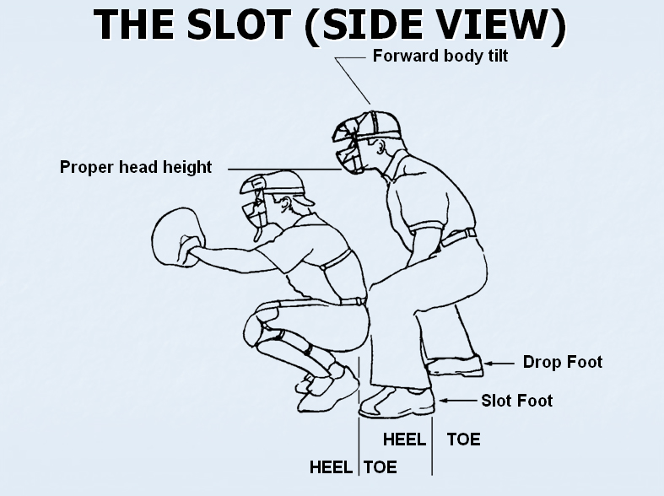
Basic Plate Starting Positions
Right-Handed Batter

Slide 9
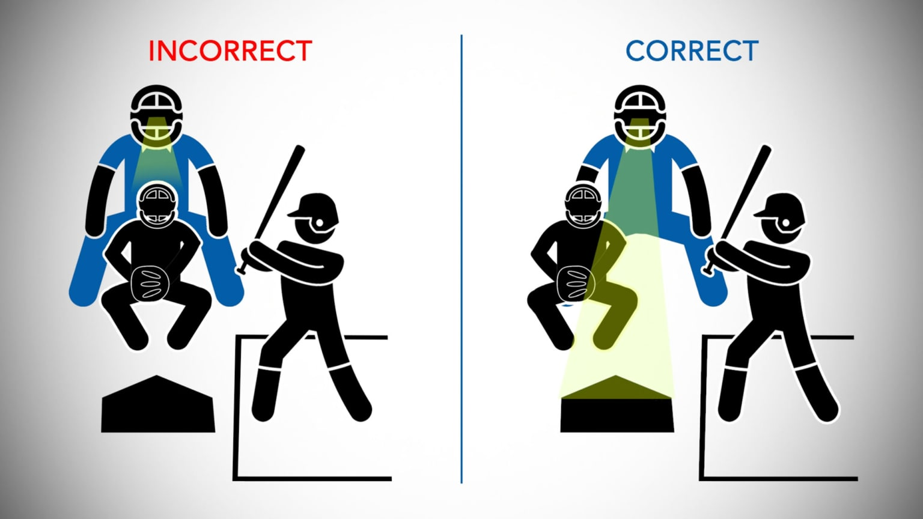
Basic Plate Starting Positions
Right-Handed Batter

Slide 10
Strike Zone

Slide 11
“A” Position - Starting
U1
BR
PU

Slide 12
No Runners on Base Ground ball in the Infield Not to 1B or 2B coming towards the line

Slide 13
“A” Position - Starting
U1
U1
BR
PU

Slide 14
No Runners on Base Ground ball in the Infield to 1B or 2B coming towards the line

Slide 15
“A” Position - Starting
U1
U1
BR
PU

Slide 16
No Runners on Base Clean base hit through the infield or straight to the outfield

Slide 17
“A” Position - Starting
U1
U1
BR
PU
PU

Slide 18
No Runners on Base Fly ball between Right-Center Field and the Right Field Foul Line

Slide 19
“A” Position - Starting
U1
U1
U1
Watch
BR
PU

Slide 20
No Runners on Base Fly ball between Center Field and the Left Field Foul Line

Slide 21
“A” Position - Starting
U1
U1
Watch
BR
PU

Slide 22
B Position Runner on 1st

Slide 23
“B” Position - Starting
U1
R1
PU

Slide 24
B Position Clean hit to the outfield

Slide 25
“B” Position - Rotation
U1
R1
PU
PU
BR
PU

Slide 26
C Position Clean hit to the outfield

Slide 27
“C” Position - Starting
R2
U1
R1
R3
PU

Slide 28
C Position Runners on 1st and 2nd Fly Ball to the outfield

Slide 29
“C” Position - Rotation
R2
U1
PU
R1
PU
PU

Slide 30
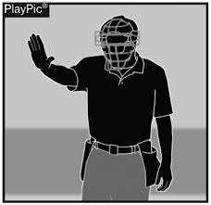
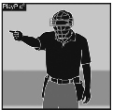
Hand Signals
Do Not Pitch
Play Ball (Play)

Slide 31
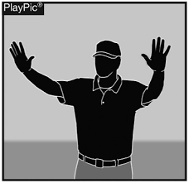
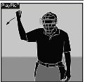
Hand Signals
Foul Ball,
Time-Out,
Dead Ball
Strikeout

Slide 32
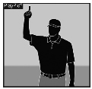
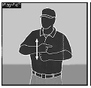
Hand Signals
Infield Fly
Double Tag Rotation

Slide 33
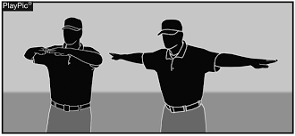
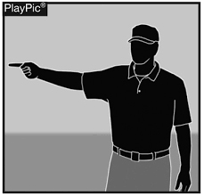
Hand Signals
Safe,
Missed Tag,
No Catch,
No Swing
Fair Ball

Slide 34
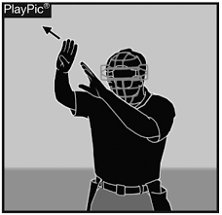
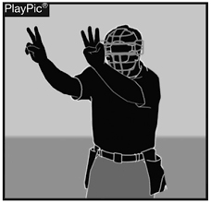
Hand Signals
Foul Tip
Count

Slide 35
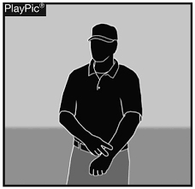
Hand Signals
Time Play
Correct Rotation

Slide 36
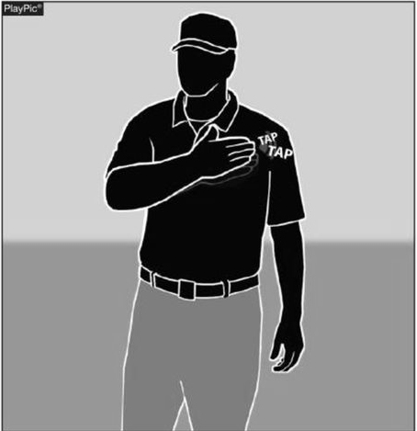
Hand Signals
Information Available

Slide 37
Mechanics
2-Person Umpire System

