Slide 1
2024 NFHS Baseball Rule changes and Points of emphasis

Slide 2
Updates from NYSBUA – President’s Report
Uniform Changes Approved at Fall 2023 Meeting
Black uniform shirt is now the default color
Charcoal gray pants are the only pants approved
Heather gray pants are no longer allowed

Slide 3
2024 NFHS BASEBALL
Rules Changes

Slide 4
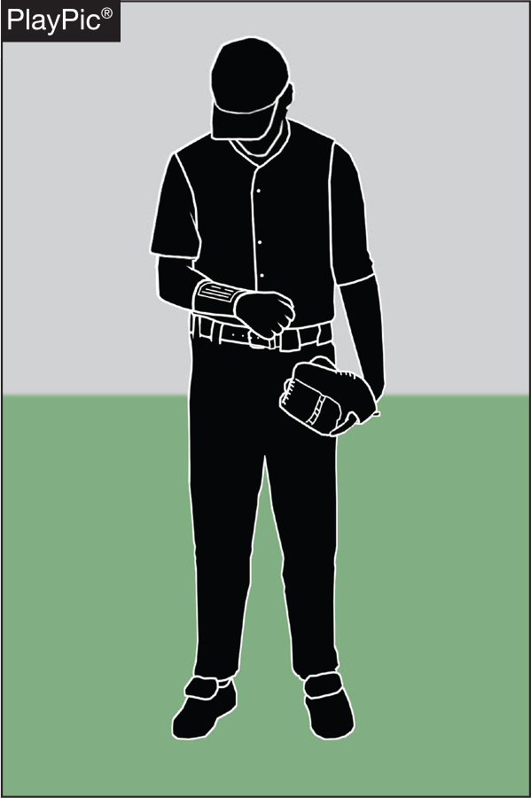
1-6-1 PLAYER COMMUNICATION EQUIPMENT
• Any wristband with defensive shifts, offensive plays, pitching choices, or game directions attached shall be considered non-electronic equipment and is permitted as long as it a single, solid color.

Slide 5
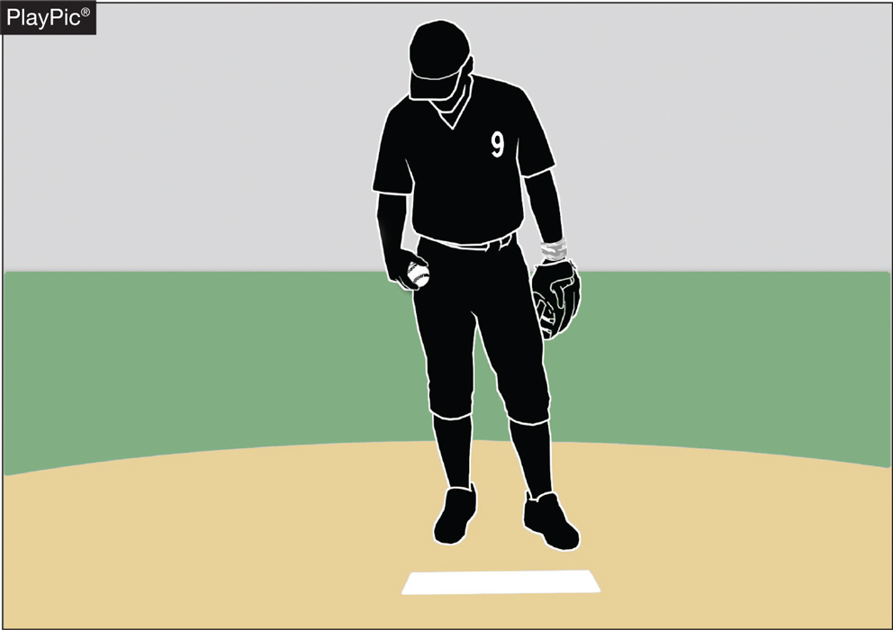
1-6-1 PLAYER COMMUNICATION EQUIPMENT
• For pitchers, it may not contain the colors white, gray or be distracting.
• It does not have to match the color of the uniform, or the sleeves worn underneath the uniform.

Slide 6
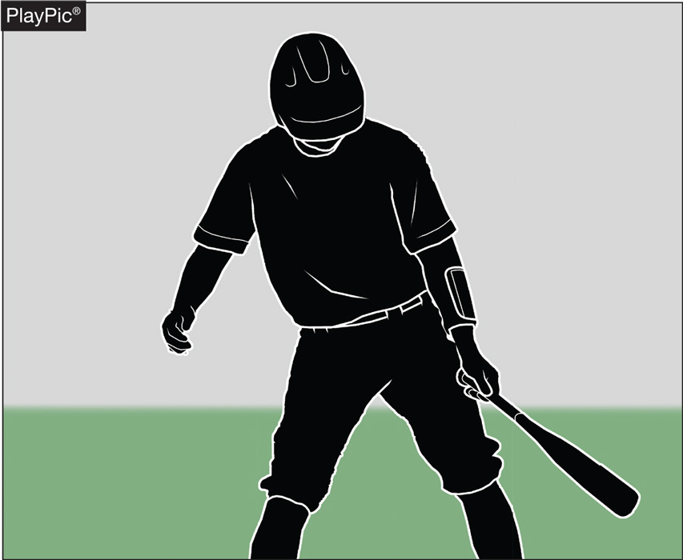
1-6-1 PLAYER COMMUNICATION EQUIPMENT
It shall only be worn on a player’s wrist or forearm
Pitchers shall wear it on their non-pitching arm.

Slide 7
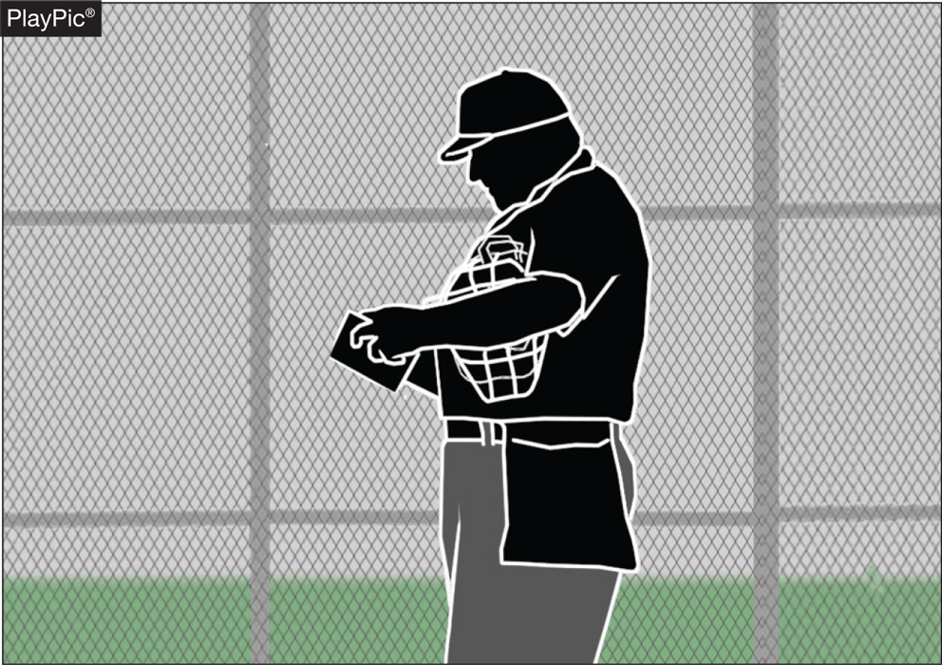
1-6-1 PLAYER COMMUNICATION EQUIPMENT
• The penalty for wearing this equipment improperly is a team warning to the coach on a first offense.
• The next offender of that team will be ejected along with the team’s head coach.

Slide 8
player communication equipment Rule 1-6-1 (New section)
ART. 1 . . . Any wristband with defensive shifts/offensive plays/pitching choices or game directions attached shall be considered non-electronic equipment and is permitted as long as it is a single, solid color. For pitchers, it may not contain the colors white, gray or be distracting. It does not have to match the color of the uniform or the sleeves worn underneath the uniform. It shall only be worn on a player(s) wrist or forearm and pitchers shall wear it on their non-pitching arm.
PENALTY: The umpire shall issue a team warning to coach of the team involved and the next offender(s) of that team will be ejected along with the head coach.
Rationale:
Clarification. With the increase in popularity of these style of communication systems, confusion has been realized when the players wear them other than on their arm. This change will prohibit these types of products from being worn other places.

Slide 9
Example 1 – The Play
The pitcher is wearing a red wristband on the non-throwing arm. The card within the wristband that contains pitch information on it is white.
What is the ruling?

Slide 10
Example 1 – The answer
The wristband is illegal and must be removed unless the white card is covered by a flap which is the same color as the wristband.
Case Play 1.6.1. Situation B page 14

Slide 11
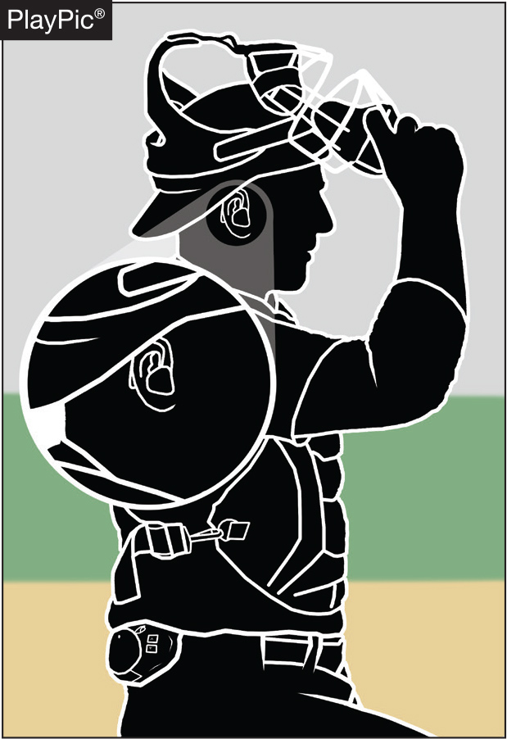
PLAYER COMMUNICATION EQUIPMENT rule 3-2-5
• One-way electronic communication devices are permissible from the dugout to the catcher while the team is on defense for the purpose of calling pitches.

Slide 12
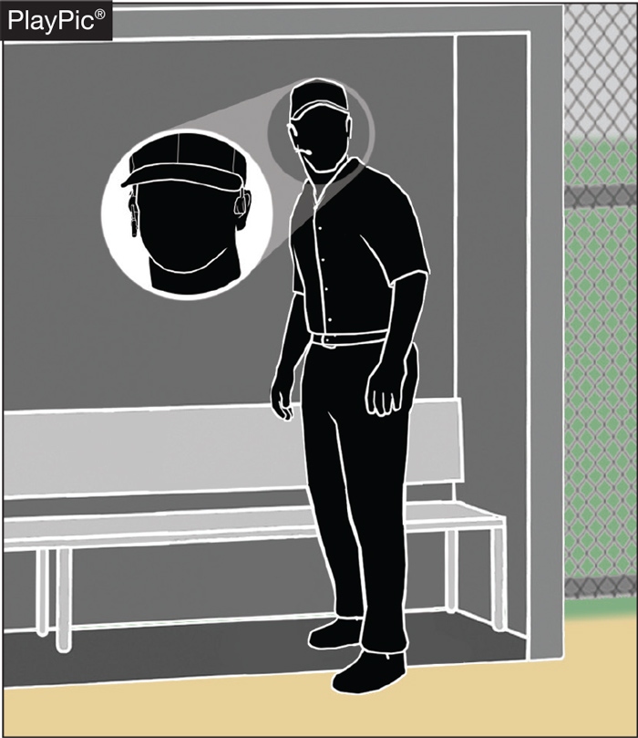
PLAYER COMMUNICATION EQUIPMENT rule 1-6-2
When using the electronic communication device, the coach cannot be outside the dugout/bench area.
Various technologies like an earpiece, an electronic band or a smart watch could be used.

Slide 13
player communication equipment Rule 1-6-2 (New section)
ART. 2 . . . One-way electronic communication devices are permissible from the dugout to the catcher while the team is on defense for the purpose of calling pitches. When using the electronic communication device, the coach cannot be outside the dugout/bench area.
PENALTY: The umpire shall issue a team warning to coach of the team involved and the next offender(s) of that team will be ejected along with the head coach.
Rationale:
This rule allows for a team to utilize an electronic device for the purpose of calling pitches from the dugout. The device would only be able to be one-way, meaning the player cannot use an electronic device to respond or communicate back to the coach. Various technologies, earpiece, electronic band or a smart watch could be used giving teams several options at varying costs. No other player would be able to wear or use this device nor would the coach be able to communicate with any other player using electronic communication.

Slide 14
Example 2 – The Play
The Gabriel High School catcher is wearing a one-way electronic communication device on his wrist. In the 6th inning, the catcher notices the wristwatch is no longer working. The Gabriel Head Coach requests a time out to visit with the catcher near home plate in an attempt to fix the wristwatch.
What is the ruling?

Slide 15
Example 2 – The answer
This is permitted but the defensive team is charged with a defensive conference.
Case Play 1.6.2. Situation D page 15

Slide 16
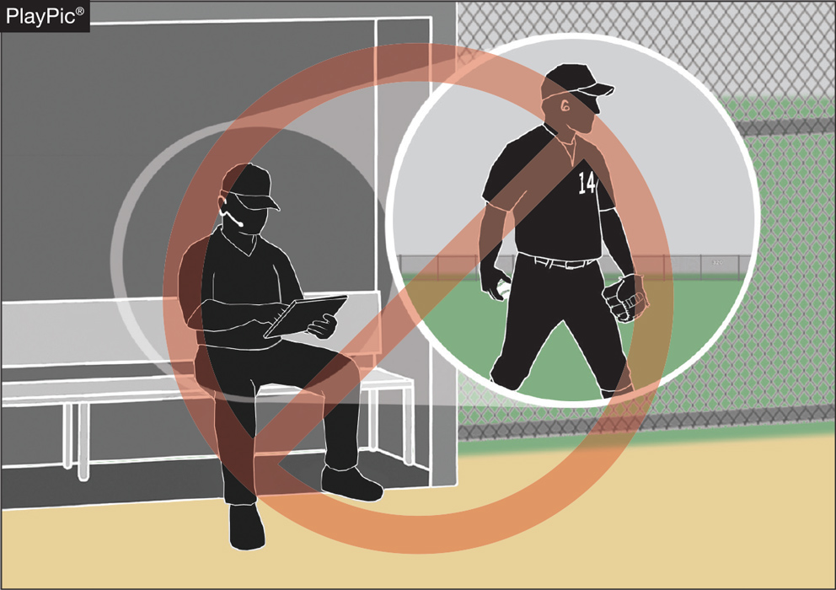
COACHING (PLAYER COMMUNICATION EQUIPMENT) rule 3-2-5
• Coaches may not use electronic communication device(s) to communicate with any other team member other than the catcher while on defense (including any team member while on offense).

Slide 17
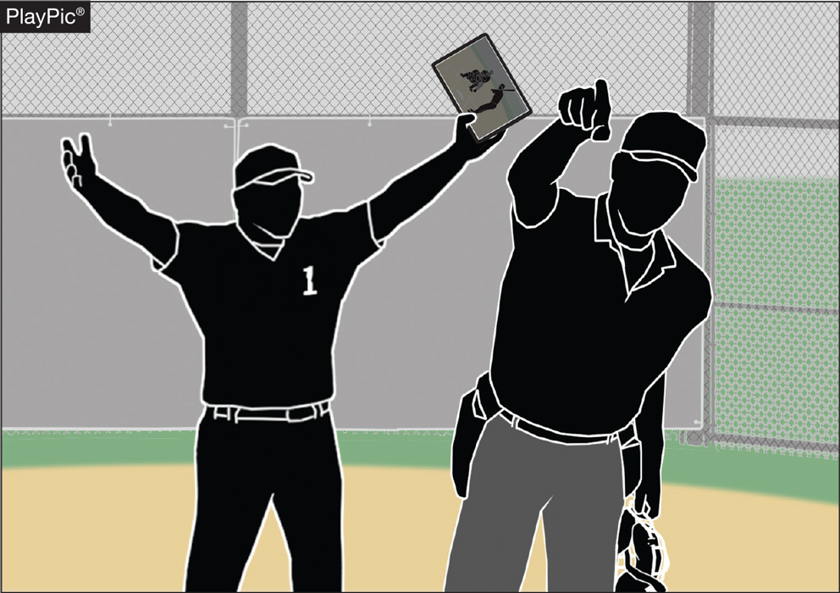
COACHING (PLAYER COMMUNICATION EQUIPMENT) rule 3-2-5
• The penalty for improper use is a team warning on the first offense.
• The next offender of that team will be ejected along with the team’s head coach.

Slide 18
Coaching rule 3-2-5
ART. 5 . . . A coach may use a one-way electronic communication device to communicate to the catcher for the purpose of calling pitches. Coaches may not use electronic communication device(s) to communicate with any other team member while on defense or any team member while on offense. When using the electronic communication device, the coach cannot be outside the dugout/bench area.
PENALTY: The umpire shall issue a team warning to coach of the team involved and the next offender(s) of that team will be ejected along with the head coach.
Rationale:
Allows for the coach to communicate with the catcher using an electronic communication device for the purpose of calling pitches.

Slide 19
Example 3 – The Play
The Gabriel High School Head Coach and Pitching Coach both want to have access to the one-way electronic communication device they use to communicate with the catcher.
What is the ruling?

Slide 20
Example 3 – The answer
This would not be allowed.
Only one communication device is allowed in the dugout/bench.
Either the head coach or the pitching coach is allowed access to the device.
Case Play 1.6.2. Situation A page 14

Slide 21
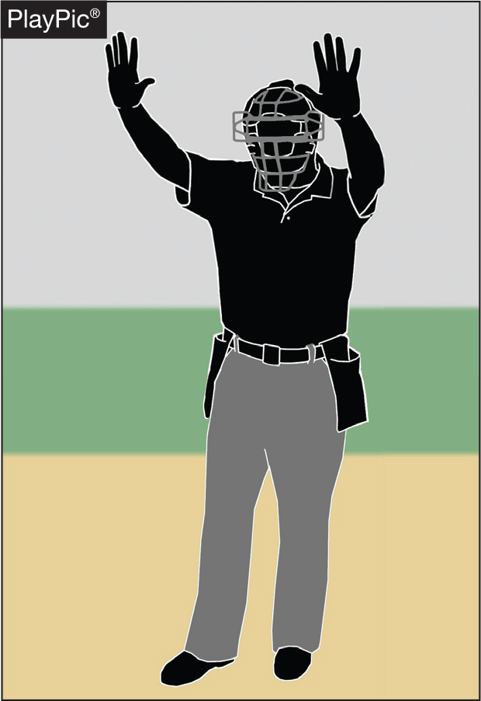
UMPIRE-IN-CHIEF Rule 10-2-3h
• The umpire-in-chief may forfeit the game for prescribed infractions by coaches, players or team/bench personnel.

Slide 22
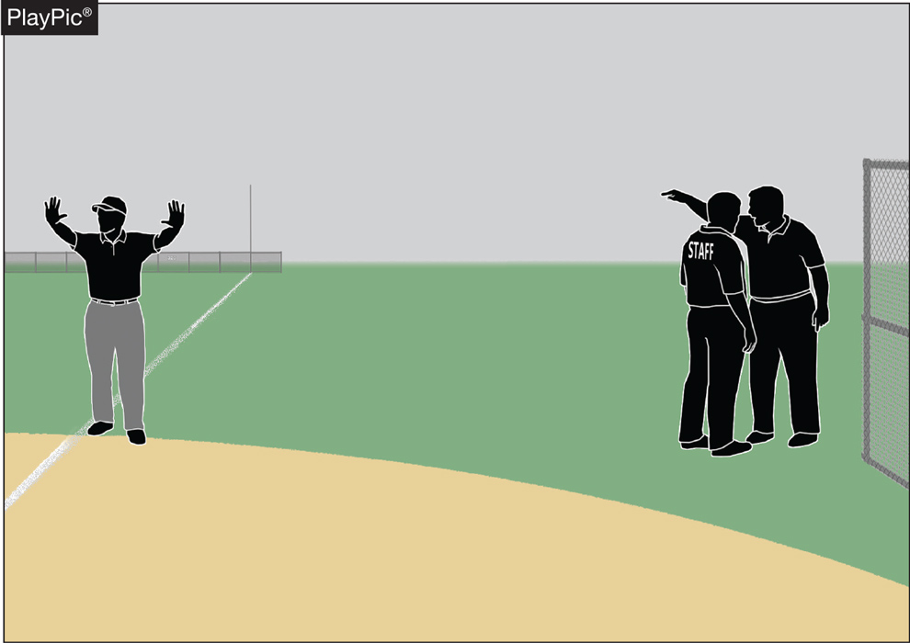
UMPIRE-IN-CHIEF Rule 10-2-3h
• Umpires have jurisdiction over the confines of the players, coaches and team/bench personnel.
• If there are issues with spectators, it is the responsibility of game management to deal with spectators and to ensure the facility is safe for all involved.

Slide 23
UMPIRE-IN-CHIEF rule 10-2-3h
h. Forfeit the game for prescribed infractions by spectators, coaches, players or team/bench personnel.
Rationale:
Umpires have jurisdiction over the confines of the field, players, coaches and team/bench personnel. If there are issues with spectators, it is the responsibility of game management to deal with spectators and to ensure that the facility is safe for all involved.

Slide 24
2024 NFHS BASEBALL
Points of Emphasis

Slide 25
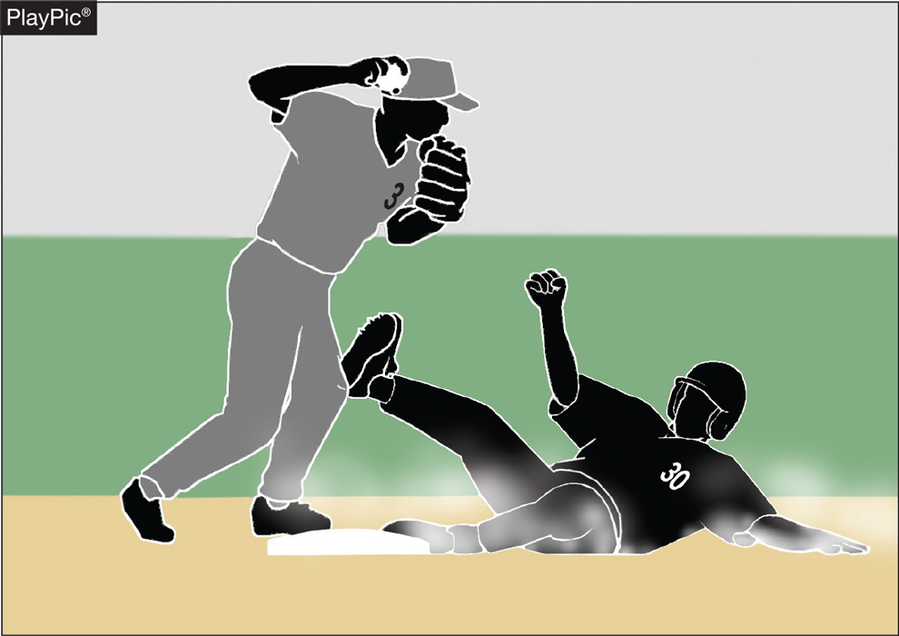
Malicious contact
Malicious contact can be initiated by either an offensive or defensive player(s).
It should not be confused with incidental contact or “train wreck” plays that sometimes occur in baseball.
Notes:
NFHS playing rules are written to encourage sportsmanship. Participation in these programs should promote respect, integrity and sportsmanship. However, for these ideals to occur, everyone involved in these programs must be doing their part.
Sportsmanship, or good sporting behavior, is about treating one another with respect and exhibiting appropriate behavior. It is about being fair, honest and caring. When these types of appropriate behavior occur, competitive play is more enjoyable for everyone.

Slide 26
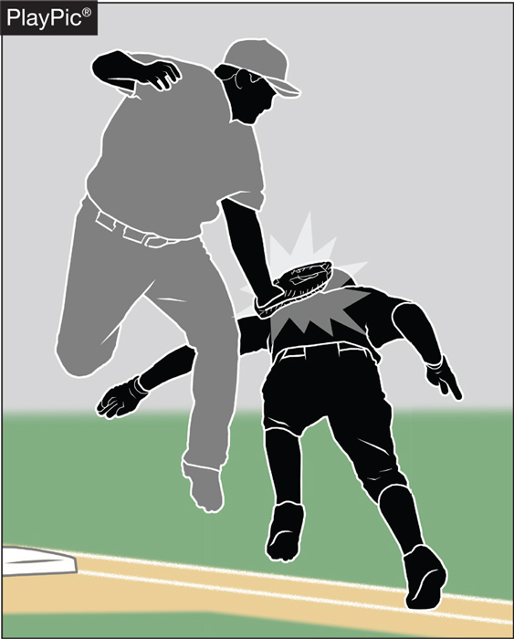
Malicious contact
Contact or a collision is considered to be malicious if it the result of excessive force and/or there is an intent to injure.
The absence of these two conditions does not preclude the presence of malicious contact but would provide a reasonable starting point for proper interpretation.
Notes:
NFHS playing rules are written to encourage sportsmanship. Participation in these programs should promote respect, integrity and sportsmanship. However, for these ideals to occur, everyone involved in these programs must be doing their part.
Sportsmanship, or good sporting behavior, is about treating one another with respect and exhibiting appropriate behavior. It is about being fair, honest and caring. When these types of appropriate behavior occur, competitive play is more enjoyable for everyone.

Slide 27
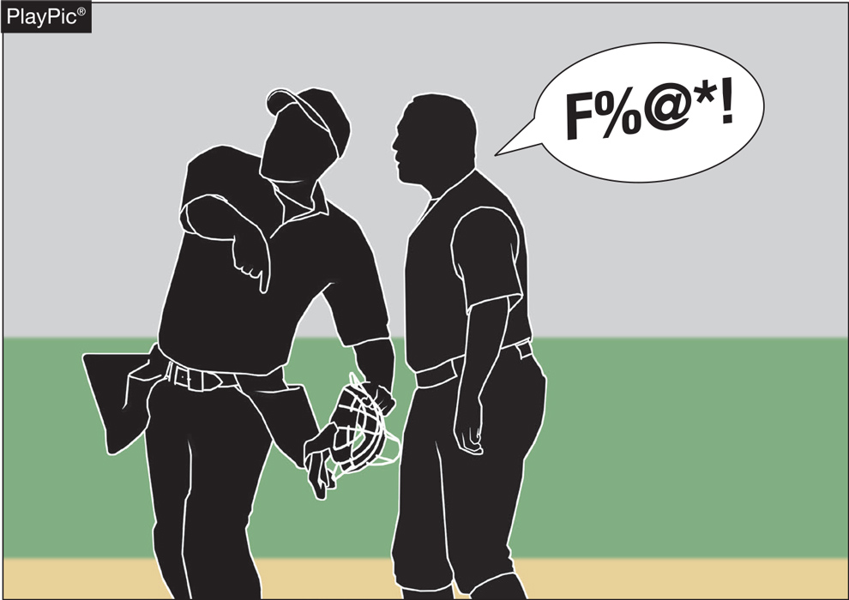
Profanity (DIRECT OR INDIRECT)
Education-based athletics is a direct extension of the classroom.
There is no excuse for foul language in school or on the baseball field.
Notes:
NFHS playing rules are written to encourage sportsmanship. Participation in these programs should promote respect, integrity and sportsmanship. However, for these ideals to occur, everyone involved in these programs must be doing their part.
Sportsmanship, or good sporting behavior, is about treating one another with respect and exhibiting appropriate behavior. It is about being fair, honest and caring. When these types of appropriate behavior occur, competitive play is more enjoyable for everyone.

Slide 28
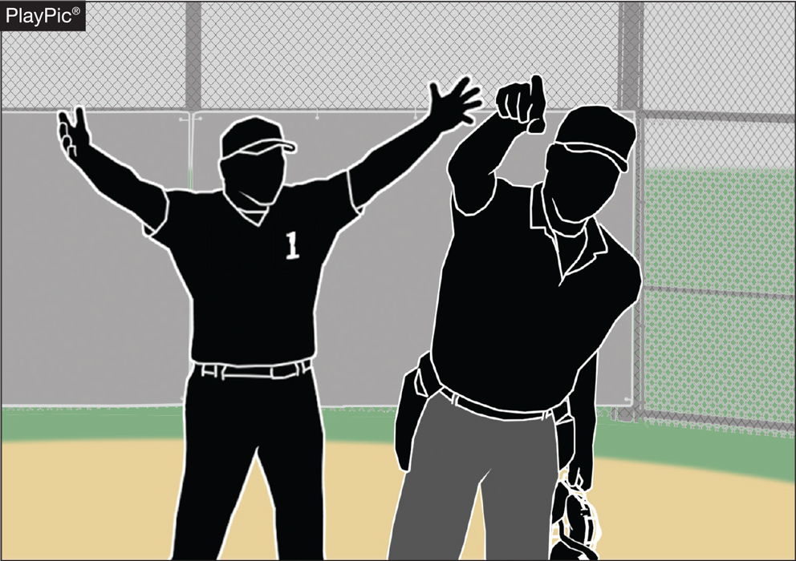
Profanity (DIRECT OR INDIRECT)
The penalties are:
a verbal warning to the offender on the first offense
a written warning to the offender that warrants restriction to the dugout for the remainder of the game for a second offense
ejection for a major offense.
Notes:
NFHS playing rules are written to encourage sportsmanship. Participation in these programs should promote respect, integrity and sportsmanship. However, for these ideals to occur, everyone involved in these programs must be doing their part.
Sportsmanship, or good sporting behavior, is about treating one another with respect and exhibiting appropriate behavior. It is about being fair, honest and caring. When these types of appropriate behavior occur, competitive play is more enjoyable for everyone.

Slide 29
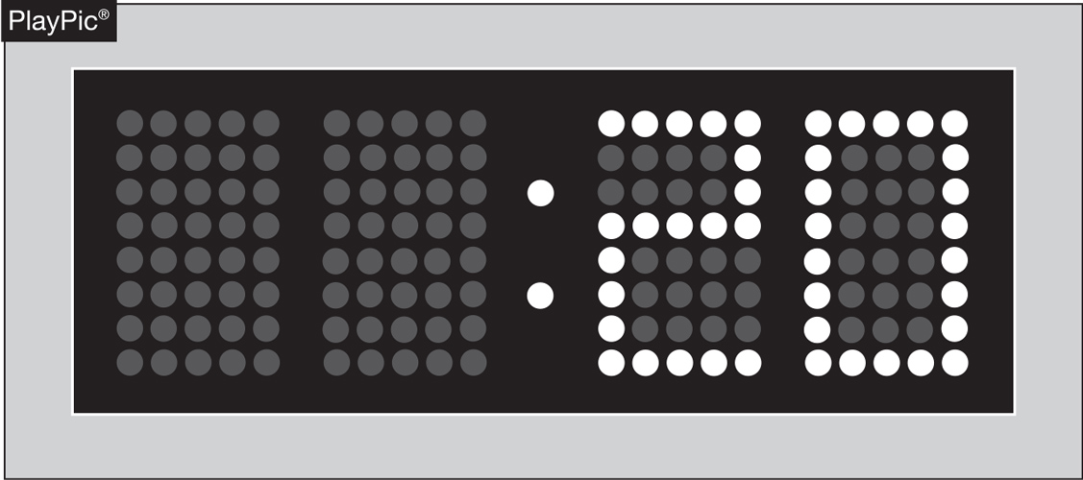
PACE OF PLAY
A 20-second time limit rule has been in the NFHS rules book since the 1970s.
The rule is meant to only be utilized when other preventive umpiring measures fail to achieve a reasonable pace or rhythm.
Notes:
NFHS playing rules are written to encourage sportsmanship. Participation in these programs should promote respect, integrity and sportsmanship. However, for these ideals to occur, everyone involved in these programs must be doing their part.
Sportsmanship, or good sporting behavior, is about treating one another with respect and exhibiting appropriate behavior. It is about being fair, honest and caring. When these types of appropriate behavior occur, competitive play is more enjoyable for everyone.

Slide 30
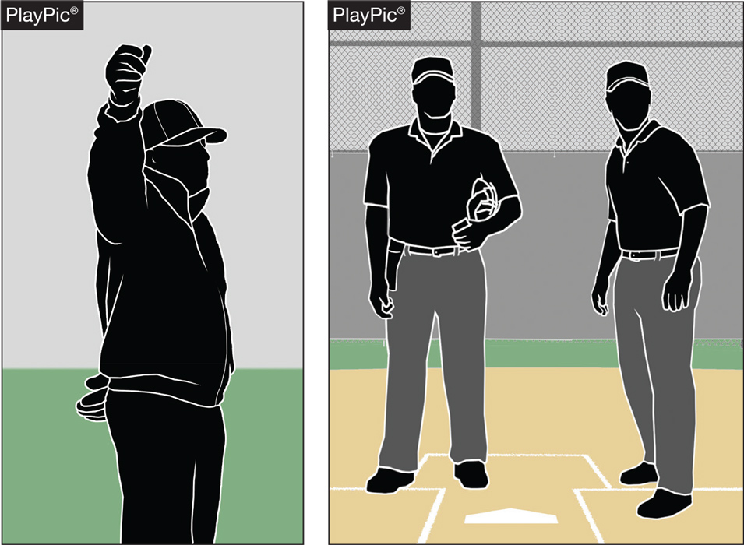
PACE OF PLAY
By rule, the time between the last out of one half-inning and the first pitch of the next half-inning is 1 minute, 20 sec.
Umpires should facilitate this and refrain from visiting with fans or having prolonged discussions with other crew members.
Notes:
NFHS playing rules are written to encourage sportsmanship. Participation in these programs should promote respect, integrity and sportsmanship. However, for these ideals to occur, everyone involved in these programs must be doing their part.
Sportsmanship, or good sporting behavior, is about treating one another with respect and exhibiting appropriate behavior. It is about being fair, honest and caring. When these types of appropriate behavior occur, competitive play is more enjoyable for everyone.

Slide 31
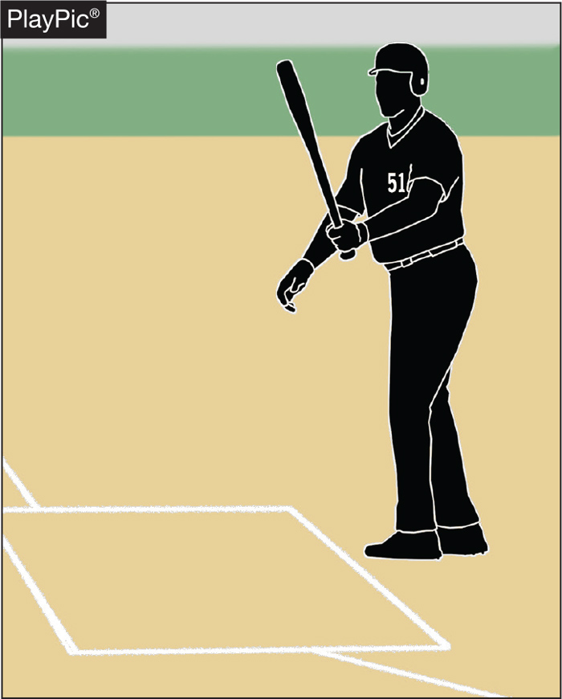
PACE OF PLAY
Rule 7-3-1 spells out the situations when a batter is allowed to leave the batter’s box.
Repeatedly stepping out to alter the rhythm of the pitcher or delay the game is not acceptable, and umpire needs to apply the proper penalty.
Notes:
NFHS playing rules are written to encourage sportsmanship. Participation in these programs should promote respect, integrity and sportsmanship. However, for these ideals to occur, everyone involved in these programs must be doing their part.
Sportsmanship, or good sporting behavior, is about treating one another with respect and exhibiting appropriate behavior. It is about being fair, honest and caring. When these types of appropriate behavior occur, competitive play is more enjoyable for everyone.

Slide 32
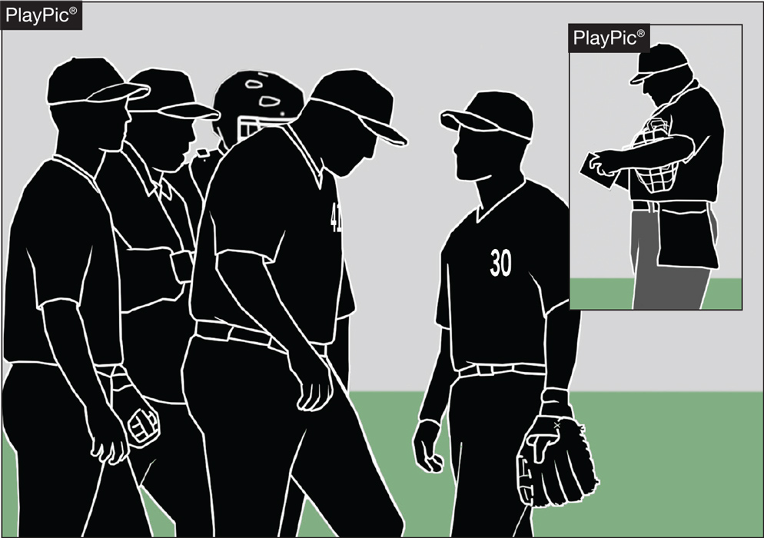
PACE OF PLAY
Umpires need to be consistent in monitoring how teams get on/off the field, conferences, enforcing the batter’s box rule and in other areas to create a sense of urgency during the contest.
Notes:
NFHS playing rules are written to encourage sportsmanship. Participation in these programs should promote respect, integrity and sportsmanship. However, for these ideals to occur, everyone involved in these programs must be doing their part.
Sportsmanship, or good sporting behavior, is about treating one another with respect and exhibiting appropriate behavior. It is about being fair, honest and caring. When these types of appropriate behavior occur, competitive play is more enjoyable for everyone.

Slide 33
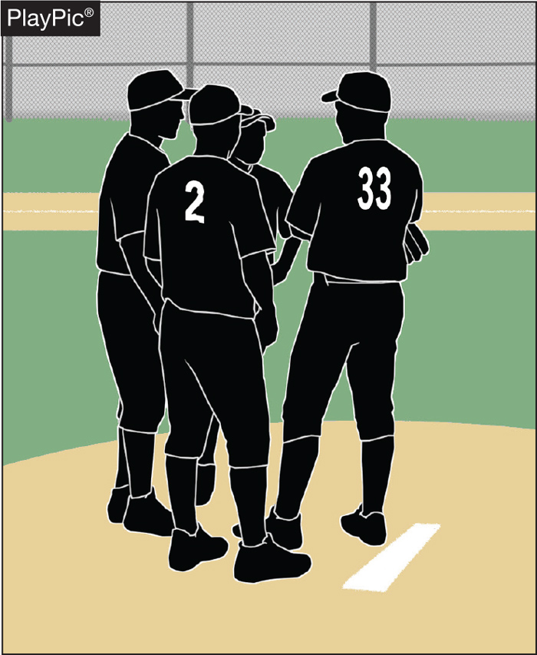
PACE OF PLAY
Umpires need to recognize when excessive player conferences begin to delay the game, step in and expedite the conclusion of the meeting.
Notes:
NFHS playing rules are written to encourage sportsmanship. Participation in these programs should promote respect, integrity and sportsmanship. However, for these ideals to occur, everyone involved in these programs must be doing their part.
Sportsmanship, or good sporting behavior, is about treating one another with respect and exhibiting appropriate behavior. It is about being fair, honest and caring. When these types of appropriate behavior occur, competitive play is more enjoyable for everyone.

Slide 34
NY State Adopted rules

Slide 35
Courtesy Runners Approved for 2024
At any time, the team at bat may use courtesy runners for the pitcher and/or the catcher.
If the offensive team bats around, the pitcher and/or catcher who had a courtesy runner on their behalf may bat in their lineup position.
The same individual player may not be used as a courtesy runner for both positions (pitcher and catcher) during the game.
Players who have participated in the game in any other capacity are ineligible to serve as courtesy runners.

Slide 36
Courtesy Runners Approved for 2024
A player may not run as a courtesy runner for the pitcher or the catcher and then be used as a sub for another player in that half inning.
The home plate umpire shall record courtesy runners on their lineup cards and announce it to the official scorer.
A player who violates the courtesy-runner rule is considered to be an illegal substitute.
Should an injury, illness, or ejection occur to the courtesy runner, another courtesy runner for the pitcher or catcher may be used.

Slide 37
Situations and plays to discuss

Slide 38
Situation 1 – The Play
The home team is utilizing Salada as the P/DH. In the second inning, Salada hits a double. The home team coach now comes to the plate umpire and tells the umpire that Connors will be a courtesy runner for Salada.
What is the ruling?

Slide 39
Situation 1 – The Answer
The home plate umpire will NOT ALLOW the use of Connors as a courtesy runner for Salada.
When Salada comes to bat, he bats as a DH and not as a pitcher.
Courtesy runners are not allowed for a DH.
Casebook Page 96 CR Situation 18

Slide 40
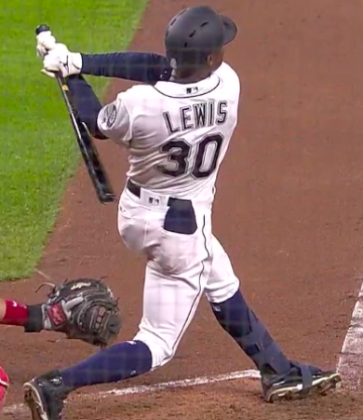
Situation 2 – The Play
A 2-2 pitch is thrown behind the batter, Healey, and makes contact with Healey’s sliding glove (“oven mitt” type glove) which was in his back pocket.
What is the ruling?

Slide 41
Situation 2 – The Answer
Call time out and award the batter first base.
The batter’s person is defined to be a player’s body, as well as the hat, helmet, uniform, shoes, protective gear, etc. worn correctly and normally.
The person of a player does not include jewelry.
The umpire may instruct the batter to remove the sliding gloves from the pocket when at-bat.
Rule 8-1-1d and Casebook Page 69 8.1.1 Situation Q

Slide 42
Situation 3 – The Play
With 1 out and Grady on first base, Rothrock hits a hard ground ball to the short stop. The short stop fields the ground ball, steps on second base, and throws to first base to turn a double play. Grady is running standing up in a straight line to second base and is hit by the short stop’s throw. When hit by the throw, Grady is not even halfway to 2B and did not intentionally interfere with the throw.
What is the ruling?

Slide 43
Situation 3 – The Answer
This is NOT a violation of the force-play slide rule.
Grady (R1) cannot be expected to slide at that point in the base path.
The play stands and the ball remains live.
Casebook Page 86 8.4.2 Situation Z

Slide 44
Situation 4 – The Play
On an 0-1 pitch, Williams hits a pop fly towards first base. The first baseman attempts to make the play, but due to the wind, drops the ball.
The plate umpire signals the ball as fair, but the base umpire both verbalizes and signals the ball was foul.
What is the ruling?

Slide 45
Situation 4 – The Answer
The foul ball call by the base umpire will prevail.
Williams would return to the plate with an 0-2 count.
Casebook Page 46 5.1.1 Situation B

Slide 46
Thank you and have a great Baseball season!
www

