Slide 1
2020 NFHS Baseball Rules Powerpoint
B. Elliot Hopkins, MLD, CAA
NFHS Director of Sports, Sanctioning and Student Services
Notes:
Thank you for participating in this annual interpretation meeting. While the rules of baseball are in great shape, we continue to work toward improving the sport by recruiting and retaining more young people. We have to continue to strive to provide safe conditions and place them in situations that they are able to find success in some aspect of the sport. Ultimately, our goal is for them to be safe, have fun and gain some valuable life lessons from participation. New additions to our rules are indicated by underlining of the change. Deletions are noted by a strike-through of the deleted text.

Slide 2
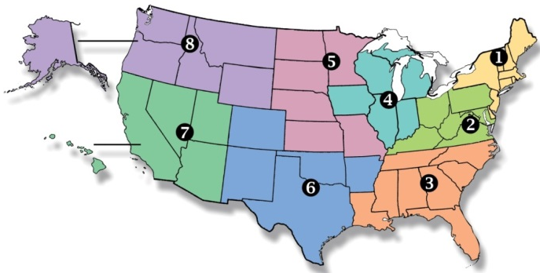
National Federation of State High School Associations
Membership = 50-member state associations and D.C.
NFHS reaches more than 19,000 high schools and 12 million participants in high school activity programs, including more than 7.8 million in high school sports.
Notes:
Services of the NFHS reach more than 19,000 high schools and 12 million participants throughout the 8 NFHS sections across the U.S.

Slide 3
NFHS Rules Review Committee
The NFHS Rules Review Committee is chaired by the chief operating officer and composed of all rules editors. After each committee concludes its deliberations and has adopted its recommended changes for the subsequent year, such revisions will be evaluated by the Rules Review Committee.
Davis Whitfield
Chief Operating Officer
Lindsey Atkinson
Girls Lacrosse and Volleyball
Bob Colgate
Football and Sports
Medicine
Sandy Searcy
Softball and Swimming & Diving
Elliot Hopkins
Baseball and Wrestling
Julie Cochran
Cross Country, Gymnastics, Field Hockey and
Track & Field
James Weaver
Boys and Spirit
Theresia Wynns
Basketball and Soccer
Dan Schuster
Ice Hockey
Notes:
All rules committee recommended rules changes are vetted through the NFHS Rules Review Committee before advancing to the NFHS Board of Directors for final action. The committee is comprised of all NFHS Director of Sports and chaired by the NFHS Chief Operating Officer.

Slide 4
NEW NFHS Rules App
Rules App features:
Searchable
Highlight notes
Bookmarks
Quizzes for all sports
Easy navigation
Immediate availability
Free to paid members of the NFHS Coaches and Officials Associations
www.nfhs.org/erules for more information
Notes:
Rules Book Apps for all NFHS rules books and case books are available on iTunes and Google Play. Rules books and case books are cross-linked and enabled for searchable content.

Slide 5
Important facts and dates
2018-19 Participation Results
Baseball (4) 482,740 [down from 2017-18 {487,097}]
Girls’: 1,284 (down from 2017-18 1,762)
Online Interpretation Meeting Date
January 23, 2020
Mid-Season Webinar Date
April 24, 2020
Rule Change Proposal Submission Dates
Open Date: September 1, 2019
Close Date: May 1, 2020
Rules Committee Date
June 5-7, 2020

Slide 6
2020 NFhs baseball rule changes

Slide 7
Designated hitter Rule 3-1-4
The DH may still be a 10th starter hitting for any one of the nine starting defensive players.
Notes:
The designated hitter has been a mainstay rule for decades. It has not changed. We have only added another option with the same concept.

Slide 8
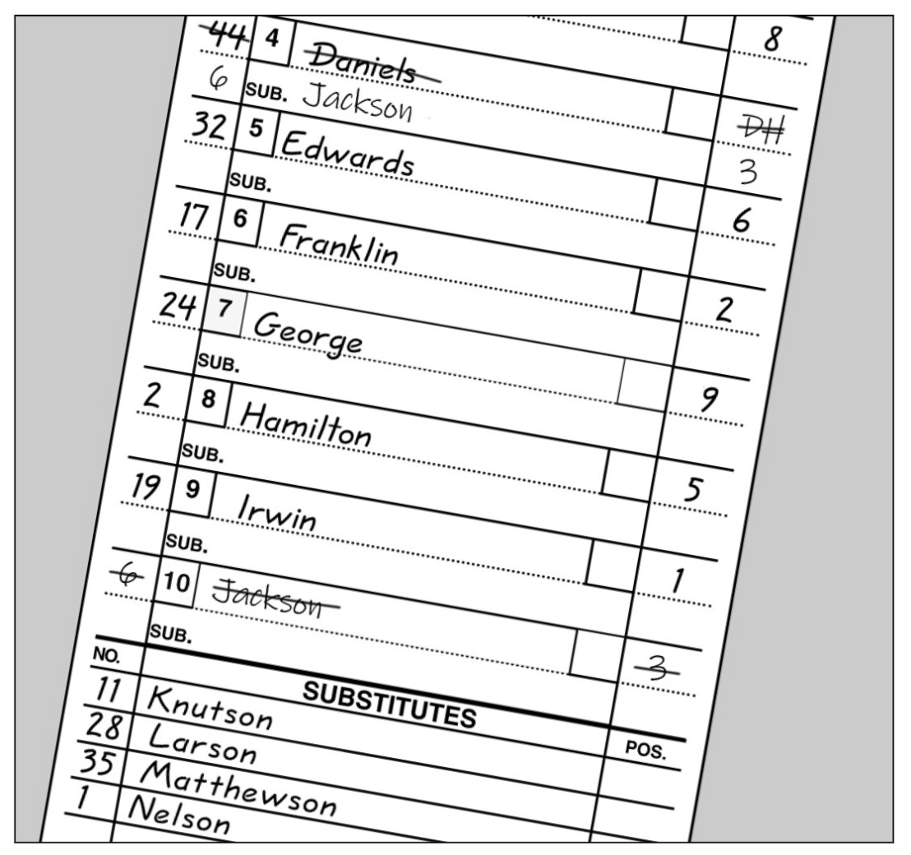
Designated hitter Rule 3-1-4a1
When using a standard designated hitter, the role of the DH is still terminated for the remainder of the game when
the defensive player (or any previous defensive player) for whom the DH batted, subsequently bats, pinch-hits or pinch-runs for the DH.

Slide 9
Designated hitter Rule 3-1-4a2
The role of a standard DH is still terminated for the remainder of the game when the designated hitter or any previous designated hitter assumes a defensive position.

Slide 10
Designated hitter Rule 3-1-4b
The starting designated hitter (DH) may now be any one of the starting defensive players, including the pitcher.
A Player/DH then holds two positions: defensive player and designated hitter.

Slide 11
Designated hitter Rule 3-1-4b
In the case where one player is listed as a starting DH and a starting defensive player in the lineup, the role of the defensive player may be substituted for by any legal substitute.
The original player/DH may re-enter defensively one time.

Slide 12
Designated hitter Rule 3-1-4b-1
When using the Player/DH, the role of the DH is terminated for the remainder of the game when any player substitutes offensively for the DH.

Slide 13
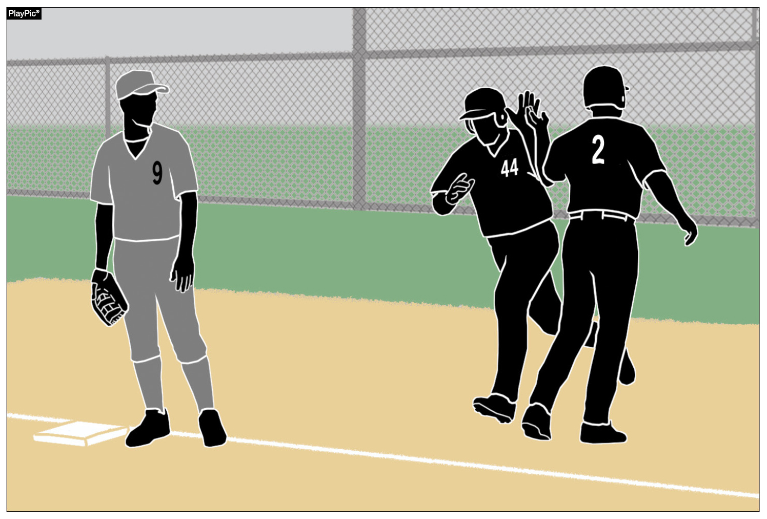
Designated hitter Rule 3-1-4b-2
As a reminder from the previous slide, the role of the DH is terminated for the remainder of the game when the starting defensive Player/DH is substituted for either as a hitter or a runner.

Slide 14
Designated Hitter (DH) Rule 3-1-4
ART. 4 . . . A hitter may be (not mandatory) designated for any one starting player (not just pitchers) and all subsequent substitutes for that player in the game. A starting defensive player cannot be listed as the designated hitter in the startup. A designated hitter for said player shall be selected prior to the start of the game, and his name shall be included on the lineup cards presented to the umpire-in-chief and to the official scorer.

Slide 15
Designated Hitter (DH) Rule 3-1-4
A team forfeits the use of a designated hitter if it fails to declare a designated hitter prior to the game. If a pinch hitter or pinch runner for the designated hitter is used, that player becomes the new designated hitter. The player who was the designated hitter may re-enter as the designated hitter under the re-entry rule. A designated hitter and the player for whom he is batting are locked into the batting order. No multiple substitutions may be made that will alter the batting rotation.
Notes:
If a pinch hitter or pinch runner for the DH is used, that player becomes the new DH under the first option (the standard DH).

Slide 16
Designated Hitter (DH) Rule 3-1-4
The role of the designated hitter is terminated for the remainder of the game when: A designated hitter may be used in one of the two scenarios:
a.The defensive player, or any previous defensive player for whom the designated hitter batted, subsequently bats, pinch-hits, or pinch-runs for the designated hitter; or
a. The designated hitter may be a tenth starter hitting for any one of the nine starting defensive players. If the designated hitter (DH) is used in this manner, the role of the DH is terminated for the remainder of the game when:

Slide 17
Designated Hitter (DH) Rule 3-1-4
1. The defensive player, or any previous defensive player for whom the designated hitter batted, subsequently bats, pinch-hits, or pinch-runs for the designated hitter; or
2. The designated hitter or any previous designated hitter assumes a defensive position.

Slide 18
Designated Hitter (DH) Rule 3-1-4
Rationale:
This rule change will provide coaches some options to strategize how to keep their better players in the game, to contribute to the offensive output of the team and give another player a chance to participate on defense. In addition, considering the pitch count rules, this change would help pitchers to keep their bat (because they are typically the best hitter) in the game, but can come out of the game to protect their arms from overuse.

Slide 19
Let’s test our knowledge
Four examples to discuss when it comes to the DH rule…

Slide 20
Example 1
DH Jones, batting in the second spot in the lineup for starting F5 Baker, safely reaches first base. The head coach substitutes Miller as a pinch runner for DH Jones at first base. Is the position of DH terminated for the remainder of the game?

Slide 21
Example 1 Answer
No! The DH has been out of the game once. Miller may become the new DH or the original DH Jones may re-enter as DH (or may play defense).
If any standard DH plays defense, the role of the DH is terminated.
Casebook 3.1.4 Situation B pages 25 – 26

Slide 22
Example 2
With Draper listed in the starting lineup as the 2B/DH and batting fourth in the batting order, the head coach wants to bring in Gabriel to hit for Draper.
What happens to the position of DH?

Slide 23
Example 2 answer
If substitute Gabriel comes in to hit (or run) for Draper, the role of the DH is terminated for the game.
If eligible, Draper may re-enter the game on defense and bat in the same spot in the batting order.
Casebook 3.1.4 Situation H page 26

Slide 24
Example 3
Williams is listed as the P/DH hitting in the third position in the batting order. In the 5th inning, Grady enters the game as pitcher (with Williams reaching his pitch count limit) and Williams continues as DH for Grady. In the 6th inning, Olsen enters to pitch replacing Grady with Williams continuing as DH for Olsen. In the 7th inning, Williams returns to defense as the catcher and is still listed as the DH.
Is Williams allowed to return to defense and still be listed as DH?

Slide 25
Example 3 answer
This is legal (Casebook 3.1.4 Situation F page 26)
The starting P/DH has two positions: the defensive player and the designated hitter.
If the defensive player has been substituted for, the original player/DH may re-enter one time.
The role of this DH is terminated when:
A substitute (or former substitute) for the defensive role subsequently participates in an offensive role
The starting defensive player/DH is substituted for either as a hitter or a runner.

Slide 26
Example 4
In the 4th inning, Smith replaces Rothrock as the starting P/DH as the pitcher only. In the 4th inning, Rothrock sprains his ankle as he slides into third base on a triple. Rothrock cannot continue and so the head coach enters Kaiser as a pinch-runner.
What happens to Smith in this scenario?

Slide 27
Example 4 answer
If an eligible substitute enters the game to pinch-run for Rothrock, the role of the DH is terminated and Rothrock is removed from the game.
This will end Smith as the pitcher since the substitute Kaiser enters the game in the batting order spot already occupied by Smith.
Casebook 3.1.4 Situation I (page 26)

Slide 28
What about NY’s p/dh rule from 2019?
How does this rule affect the 2019 rule in NY concerning the P/DH?
Will NY eliminate the P/DH rule from 2019 with the implementation of this new expanded form of the NFHS DH rule?
Answer: TO BE DETERMINED

Slide 29
Points of emphasis

Slide 30
Designated hitter
There are now two options when using a designated hitter: the standard DH and the player/DH. Teams may also still choose to start the game without using a designated hitter (straight 9). All options must be declared prior to the start of the game.

Slide 31
Designated hitter
The courtesy runner (CR) can never have any function with a designated hitter (DH). When a DH comes to bat, he is a DH (regardless of either lineup option); when at bat, he can never assume a defensive position. As a result, a CR is never a legal substitute for a DH.

Slide 32
Designated hitter
If the DH is batting for another player, when he bats, he is a DH. As a result, if a runner comes in for him when he gets on base, it is a substitution, and that player is now the DH. If the DH is a Player/DH, he is batting as the DH. A substitution by an offensive player would eliminate the role of the DH.

Slide 33
Game-ending procedures
A state association may adopt game-ending procedures that determine how games are ended, including suspended games. However, if a state does not adopt game-ending procedures, by mutual agreement of the opposing coaches and the umpire-in-chief, any remaining play may be shortened or the game terminated. If a state association has adopted game-ending procedures, only those game-ending procedures may be used, unless the opposing coaches wish to terminate the game (4-2-4).

Slide 34
Force-play slide rule
Runners are never required to slide, but if a runner elects to slide at any base, it must be legal. A legal slide can either be feet first or head first. If a runner slides feet first, at least one leg and buttock shall be on the ground.

Slide 35
Force-play slide rule
Runners may not pop-up into the fielder.

Slide 36
Force-play slide rule
Runners may not have a leg raised higher than the fielder’s knee.

Slide 37
Force-play slide rule
Except at home plate, runners may not slide through or beyond the base.

Slide 38
Force-play slide rule
Runners may not slide away from a base in the direction of the fielder. But a runner may slide in a direction away from a fielder to avoid making contact or altering the play of the fielder.

Slide 39
Force-play slide rule
The runner is out when he illegally slides. On a force play, the runner is also guilty of interference. The batter-runner is also declared out and all other runners must return to the base occupied at the time of the pitch.

Slide 40
Force-play slide rule example 1
R1 is on the first base. B2 hits a ground ball to the shortstop who flips to the second baseman covering second to turn a double play. R1 runs to second base and goes in directly to second base standing up. No contact is made with the second baseman, but the second baseman must take a step to the side to make the throw to first.
What is the proper call?

Slide 41
Force-play slide rule example 1 Answer
This is interference. R1 is already out so time is called and the Batter-Runner is declared out for the interference.
Combine rules 2-32-1 and 8-4-2b

Slide 42
Force-play slide rule example 2
R1 is on the first base. B2 hits a ground ball to the second baseman who flips to the shortstop covering second to turn a double play. R1 runs to second base and goes in directly to second base standing up. No contact is made with the shortstop, but the shortstop’s throw hits R1 directly in the chest.
What is the proper call?

Slide 43
Force-play slide rule example 2 answer
This is interference. R1 is already out so time is called and the Batter-Runner is declared out for the interference.
Combine rules 2-32-1 and 8-4-2b

Slide 44
Force-play slide rule example 3
R1 is on the first base. B2 hits a ground ball to the shortstop who flips to the second baseman covering second to turn a double play. R1 runs to second base and goes in directly to second base standing up. As R1 reaches second base, he makes contact with the second baseman as he is reaching second base.
What is the proper call?

Slide 45
Force-play slide rule example 3 answer
This is interference. R1 is already out so time is called and the Batter-Runner is declared out for the interference.
Combine rules 2-32-1 and 8-4-2b

Slide 46
COMPLIANT BASEBALL
The ball shall meet the current NOCSAE standard for baseball effective January 1, 2020. The NFHS authentication mark and the NOCSAE mark shall both be visible on the ball.

Slide 47
Baseballs Rule 1-3-1
Effective January 1, 2020 the SEI/NOCSAE mark is required on all baseballs that meet the NOCSAE standard that will be used in high school competition.
Baseballs shall have the SEI/NOCSAE mark along with the NFHS Authenticating Mark.
Rationale:
To maintain a consistent and uniform standard for high school competition. To ensure that every baseball manufactured meets the same level of quality and playability.

Slide 48
Compliant Baseball - Penalty
There is no penalty listed in the rule book.
If a baseball does not have the NOCSAE mark, report the coach/team/school to NYSPHSAA
Still play the game

Slide 49
COMPLIANT BODY AND CHEST PROTECTOR
The catcher’s body/chest protector shall meet the NOCSAE standard effective Jan. 1, 2020.
Notes:
The compliant NOCSAE Body protector will have to be worn underneath the traditional chest protector.

Slide 50
Chest and body protector Rule 1-5-3
The catcher shall wear, in addition to a head protector, a mask with a throat protector, body/chest protector that meets the NOCSAE standard at the time of manufacture (Effective January 1, 2020), protective cup (male only), and baseball protective shin guards. The SEI/NOCSAE mark is required on all body/chest protectors that meets the NOCSAE standard at the time of manufacture that will be used in high school competition.

Slide 51
Chest and body protector Rule 1-5-3
Rationale:
A SEI/NOCSAE standard has been developed to protect the heart and the cardiac silhouette from commotio cordis. The NOCSAE standard could be included in a product that is either a separate device/apparel or a device constructed into a traditional chest protector. This proposal is recommended and endorsed by the NFHS Sports Medicine Advisory Committee (SMAC) to minimize risk. The catcher has to wear either a chest protector that meets the NOCSAE standard or a body protector that meets the NOCSAE standard underneath a traditional chest protector. It is the responsibility of the coach to verify that his/her players are properly equipped and in uniform.

Slide 52
Chest and body protector - penalty
Per Elliot Hopkins:
Order the player to wear the proper equipment.
If the player does not comply, eject them from the contest.
Rule 1-5-3 Penalty

Slide 53
Chest and body protector – Example 1
Although the coach at the pregame conference verified to the plate umpire that all his players were properly equipped in accordance with NFHS rules, he notices that the catcher is wearing an old chest protector – one that does not have the SEI/NOCSAE mark on it. He asks the catcher to take his jersey off to show that he is wearing a SEI/NOCSAE-approved body protector.
Is this the correct approach?

Slide 54
Chest and body protector – Example 1
NO!
The umpire shall accept the coach’s verification that all his players are properly equipped.
The plate umpire shall not require the catcher to disrobe or unbutton his jersey to prove that he is wearing a certified body protector.
(1-5-3, 4-1-3b)

Slide 55
Chest and body protector – Example 2
At the pregame conference, the visiting coach verifies that all his players are properly equipped in accordance with NFHS rules. The catcher is wearing an old chest protector that does not have the SEI/NOCSAE mark. In the third inning, the catcher tells the umpire that he forgot his body protector and is not wearing anything under his jersey other than a plain undershirt.
What must we do in this situation?

Slide 56
Chest and body protector – Example 2
The plate umpire is to accept a coach’s verification.
Once it is known that the verification was not totally accurate, the umpire must halt the game and have the situation rectified.
The umpire will stop the game and ask the coach if there is a body/chest protector available that the catcher may use.
The game cannot resume until the catcher is legally equipped.
(1-5-3, 1-5-6)

Slide 57
COMPLIANCE OF PLAYER EQUIPMENT
A face mask/guard specifically designed for a particular helmet model may be attached after manufacture, provided that procedure is approved by the manufacturer and meets the SEI/NOCSAE standard at the time of manufacture.
Notes:
Cheek and jaw protectors are allowed to be used on batting helmets.

Slide 58
PROPER PITCHING POSITIONS
The windup is one of two legal pitching positions. For the windup, the pitcher’s non-pivot foot shall be in any position on or behind a line extending through the front edge of the pitcher’s plate.

Slide 59
PROPER PITCHING POSITIONS
The set is one of two legal pitching positions. For the set position, a pitcher shall stand with his entire non-pivot foot in front of a line extending through the front edge of the pitcher’s plate and with his pivot foot in contact with or directly in front of and parallel to the pitcher’s plate.

Slide 60
PROPER PITCHING POSITIONS
Pitchers are no longer required to have their entire pivot foot in contact with the pitcher’s plate. This recognizes that many mounds are such that it is problematic for the pitcher to have his entire pivot foot in contact with the pitcher’s plate.

Slide 61
PROPER PITCHING POSITIONS
The so-called hybrid stance is illegal as it does not meet the requirements of either the windup or set positions.

Slide 62
ENFORCEMENT OF nfhs JEWELRY RULE
Jewelry, including necklaces, bracelets and earrings, shall not be worn except for religious or medical medals. A religious medal must be taped and worn under the uniform. A medical alert must be taped and may be visible.

Slide 63
NY State Adopted rules

Slide 64
NY State adopted rules – Page 65
1-2-9: We do not allow a double-first base.
1-4-4: To allow for special occasions, commemorative or memorial patches, that will be uniformly placed, not to exceed 4 square inches, to be worn on jerseys in an appropriate and dignified manner without compromising the integrity of the uniform.
If a school/coach contacts you or your chapter about this, refer them to NYSPHSAA.
Let NYSPHSAA make the decision.

Slide 65
NY State adopted rules – Page 66
2-33-1: Suggested speed-up rules. (Check with your league office).
4-2-2: 10 run rule. Each section has the option to approve the rule and then each league has the option to approve the rule.
4-2-4: Game-ending procedures may be determined.
4-3-1: Cross out! We do not have this rule.
4-4-1a: State associations are authorized to specify the time frame and/or circumstances before a forfeit shall be declared for a late arrival by one of the teams.
4-5-1: Protests are allowed in NY.
10-1-9: Visit the NYSBUA website for our uniform code.

Slide 66
Concussions – page 72
Recognize common signs and symptoms of a concussion.
Suggested Concussion Management:
No athlete should return to play on the same day of a concussion.
Any athlete suspected of having a concussion should be evaluated by an appropriate health-care professional as soon as possible.
RULE 3-1-5 (page 28): “Any player who exhibits signs, symptoms or behaviors consistent with a concussion shall be immediately removed from the game and shall not return to play until cleared by an appropriate health-care professional.”

Slide 67
Blood – page 74
Student-athlete who is:
bleeding, has an open wound, has any amount of blood on a uniform, or has blood on their body shall be directed to leave the game until:
the bleeding is stopped, the wound is covered, the uniform and/or body is appropriately cleaned, and/or the uniform is changed before returning to the game.
Any blood exposure or bites to the skin that break the surface must be reported and immediately evaluated by an appropriate health-care professional.

Slide 68
Lightning or thunder – page 75
When thunder is heard or lightning is seen:
Vacate the field immediately.
Once play has been suspended, wait at least 30 minutes after the last thunder is heard or lightning is witnessed.
Any subsequent thunder or lightning after the beginning of the 30-minute suspension count will reset the clock and another 30-minute count should begin.

Slide 69
NFHS OFFICIALS and coaches Education

Slide 70
SPORTS-SPECIFIC Officiating COURSES www.nfhslearn.com
Introduction to mechanics and techniques used in each sport
Ideal for new officials or those in first few years of officiating
30-45 minutes to complete
Topics vary based on the needs of the officials in the sport
NFHS Officials Association members cost is $10
Non-members - course is $20
API available to state associations to collect results
Notes:
SPORTS-SPECIFIC OFFICIATING COURSES
Introduction to mechanics and techniques used in each sport
Ideal for new officials or those in first few years of officiating
30-45 minutes to complete
Topics vary based on the needs of the officials in the sport
Course is FREE to any NFHS Officials Association member
Non-members course is $20
Contact NFHS Officials Department for details (317.972.6900)

Slide 71
NFHS OFFICIALS EDUCATION SPORT-SPECIFIC COURSES
Courses Available
Officiating Football
Soccer – Fouls and Misconduct
Swimming and Diving
Officiating Wrestling
Officiating Basketball
Umpiring Softball
Officiating Volleyball – Ball Handling
Future Courses
Officiating Baseball
Basketball – Three-Person Mechanics
Field Hockey
Track and Field
Volleyball – Overlapping
Softball – Mechanics
Communication Among Officials and Coaches
Soccer - Offside
Notes:
NFHS OFFICIAL EDUCATION
Courses Available
Officiating Football
Soccer – Fouls and Misconduct
Swimming and Diving
Officiating Wrestling
Officiating Basketball
Umpiring Softball
Officiating Volleyball – Ball Handling
Future Courses
Officiating Baseball
Basketball – Three-Person Mechanics
Field Hockey
Track and Field
Volleyball – Overlapping
Softball – Mechanics
Communication Among Officials and Coaches
Soccer - Offside

Slide 72
NFHS Network

Slide 73
NFHS Network
By 2020, every high school sporting event in America will be streamed live.
The NFHS Network will be THE DESTINATION for fans to view these broadcasts.
www.NFHSnetwork.com
Notes:
What is the NFHS Network?
The NFHS Network captures the passion, pride, and energy of the high school experience by delivering live high school sports and events to family members and fans whenever they want, wherever they are.

Slide 74
Thank you and have a great Baseball season!
National Federation of State High School Associations PO Box 690 | Indianapolis, IN 46206 Phone: 317-972-6900 | Fax: 317.822.5700 www.nfhs.org | www

